Slide 1


Slide 2
.
JDBC

Slide 3

API (Application Programming Interface):
API is a document
They are two types of API’s are available.
1. Public API
2. Proprietary API

Slide 4
API
In java, API document contains set of class and Interfaces.
In case of ‘C’ language, API document contains set of predefined functions

Slide 5
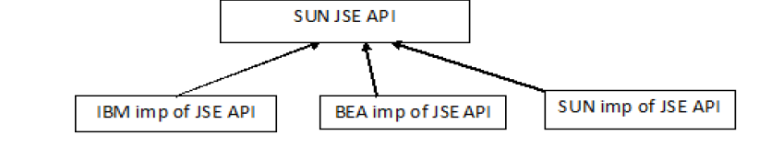
.

Slide 6
JDBC
JDBC is an API released by sun micro system.
JDBC is java data base connectivity.

Slide 7
Storage areas
Files
Database server

Slide 8
Disadvantages of File System
File system does not provide security.
There is limit on the size of the files.
If we store the data into file the redundant data will be store.

Slide 9
Database server
We can resolve this entire problem by using data base servers only.
JDBC API is used if a java application want interact with database server.
There are so many database servers are available in the market. Some of them all Oracle, MYSQL, SAP, IBMDB2, POINT database server and etc.

Slide 10
Database server
Whenever we purchase any DB server, we get two different software’s they are Database Server Program(S/W) and Database Client Program(S/W)

Slide 11
.
If we want to develop any program to communicate with they are server with database three information’s.
They are
1 ) IP Address
2 ) Service Name
3 ) Port Number

Slide 12
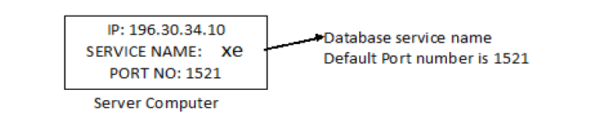
Database Server

Slide 13
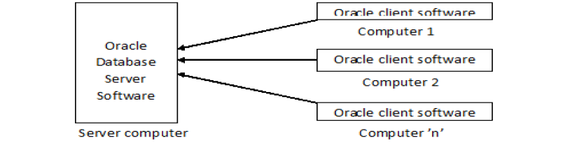
Database Client

Slide 14
.
Instead of oracle client software we are developing the java (programmer) application which interacts with database server.

Slide 15
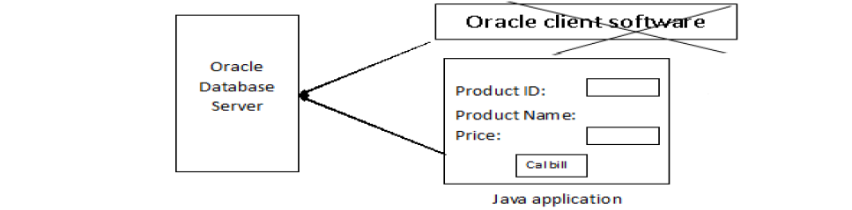
.

Slide 16
OCI functions
These functions are developed in ‘C’ language. The code inside the OCI functions interact with database server. Oracle guys are release OCI functions as part of client software.

Slide 17
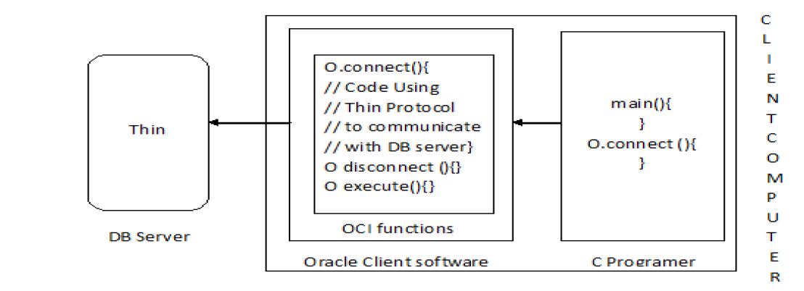
OCI

Slide 18
C vs DB
We got a project to develop in ‘C’ language to communicate with Oracle database server..

Slide 19
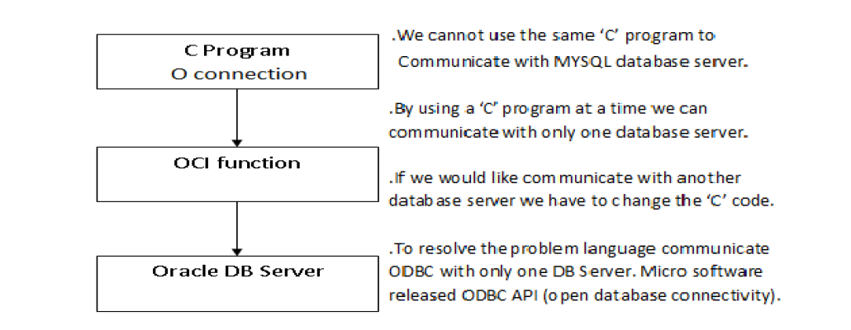
C vs DB

Slide 20
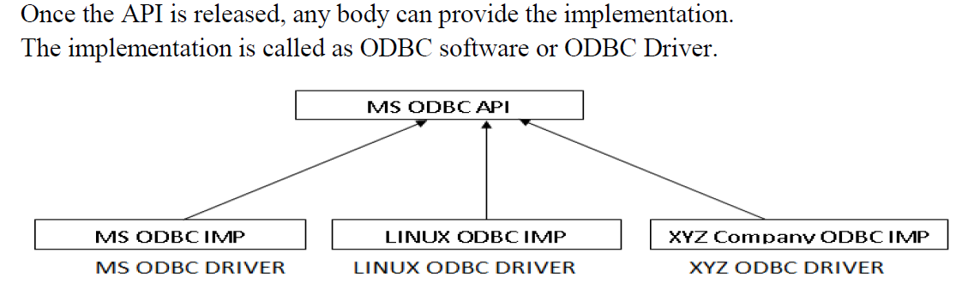
ODBC

Slide 21
JDBC
Sun Micro System released JDBC API to develop a java program to communicate with any database server without changing the java code

Slide 22
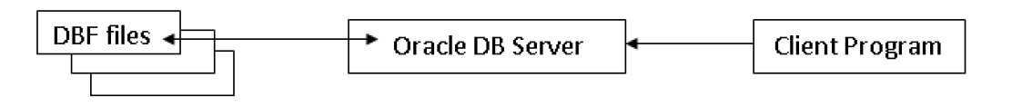
DBF

Slide 23
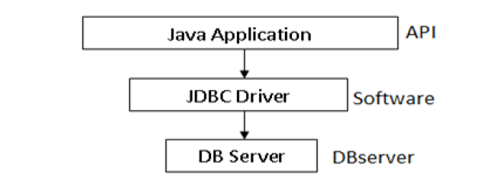
Architecture of JDBC

Slide 24
packages for JDBC
1. Java.sql
2. Javax.sql

Slide 25
java.sql interfaces
1. Driver
2. Connection
3. Statement
4. PreparedStatement
5. CallableStatement
6. ResultSet
7. DatabaseMetadata
8. ResultSetMetadata

Slide 26
java.sql classes
1. DriverManager
2. Types
3. Date

Slide 27
javax.sql interfaces:
1. DataSource
2. RowSet

Slide 28
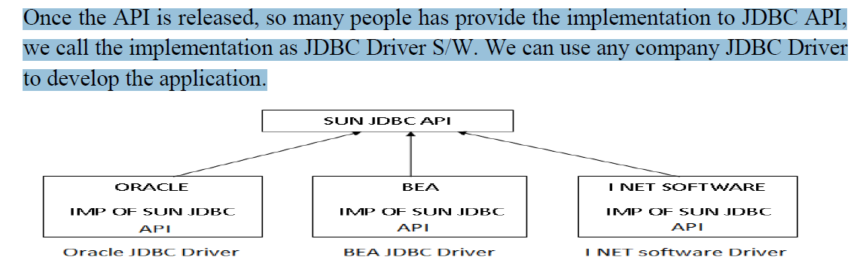
SUN JDBC

Slide 29
Steps to develop Java application
1. Register the JDBC Driver.
2. Get the Connection from the Database Server.
3. Create the Statement Object.
4. Execute the Query’s.
5. Close the Connection.

Slide 30
Driver class
A class which provides the implementation of JDBC Driver interface is called as Driver class.

Slide 31
Requirement
Develop a java program to create a table in the database server. The table name must be emp with eno, ename, salary as columns names

Slide 32
JDBC Query Types
1. Select query’s
2. Non-select query

Slide 33
Non-select queries
The query’s which does not start with select keyword are called as non-select query’s (insert, update, delete, create, drop and etc).
To execute the non-select query’s use a method execute updates.
Syntax: int executeUpdate(query);

Slide 34
Select query’s
The query’s which is start with select keyword is called as select query
To execute the select query we use a method execute query.
Syntax: ResultSet executeQuery(query);

Slide 35
Requirement:
Develop a java program to create to insert a record into DBS to emp table. We should be able to insert a record into emp table. The values are empno 1, ename Raju and salary 1000.

Slide 36
Requirement:
Develop the java application to retrieve all the records from emp table and display to the client
ResultSet rs = stmt.executeQuery(“select * from emp”);

Slide 37
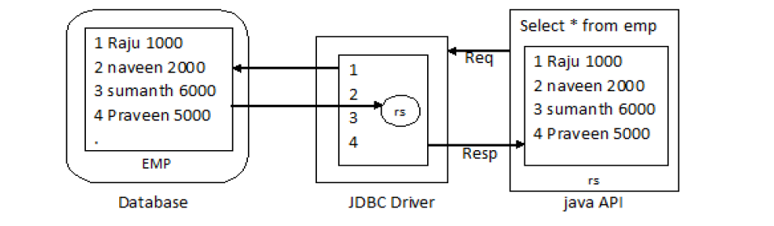
Resultset object

Slide 38
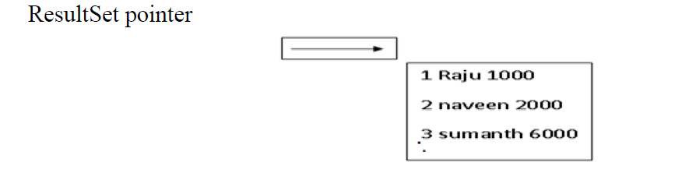
ResultSet Pointer

Slide 39
ResultSet Pointer
int getRow()
boolean next()

Slide 40
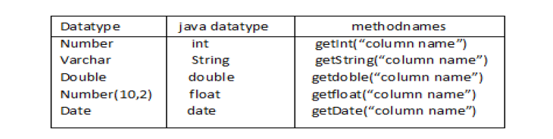
RS

Slide 41
projection
Display selected columns is called as projection.

Slide 42
PreparedStatement
PreparedStatement is also used to send the queries to DBS.
PreparedStatement improves the performance of java application when compared with statement object.
By using PreparedStatement also we can perform CURD operations.

Slide 43
Steps to create Prepared statement
Register the JDBC Driver
get the connection from database server.
Create a PrepareStatement object by supplying query as input. These query must contain positional parameters.
Ex: insert into emp values(?,?,?);
Supply the values to positional parameters by using setxxx() methods.
Execute the queries by calling executeUpadate() or executeQuery()
Close the connection

Slide 44
Requirement
Develop a java application to insert a record into emp table by using prepared statement?

Slide 45
Callable statement
Callable statements are used to call the procedures from java application

Slide 46
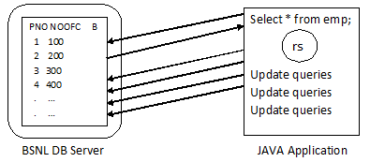
Callable statement

Slide 47
*MetaData:
Data about data is called as MetaData.
In JDBC we have two types of MetaData available. They are:
ResultSetMetaData
DatabaseMetaData

Slide 48
ResultSetMetaData:
ResultSetMetaData is an object which gives more information about ResultSet object. By using ResultSetMetaData object we can find the number of column is available in ResultSet, the names of the columns, the Data types of the columns.
Ex: ResultSetMetaData rsmd = rs.getMetaData();

Slide 49
DatabaseMetadata:
DatabaseMetadata is an object which gives more information about underline Database server. That is it can find the database server, version information and JDBC Driver information

Slide 50
Examples Resultset Metadata
ResultSetMetaData rsmd = rs.getMetaData();
System.out.println(rsmd.getColumnCount());
System.out.println(rsmd.getColumnName(2));
System.out.println(rsmd.getColumnTypeName(2));
System.out.println(rsmd.isSearchable(2));
System.out.println(rsmd.getColumnType(1));

Slide 51
Types of Drivers
TYPE 1: JDBC-ODBC Bridge Driver
TYPE 2: Native API Driver
TYPE 3: Network protocol Driver
TYPE 4: Pure java Driver/thin Driver

